Slide 1
A Tiger Cub Grows Up
Unit 6.4

Slide 2
Nonfiction

Slide 3
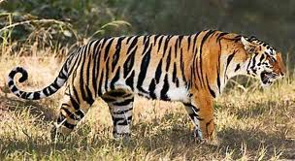
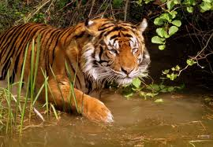
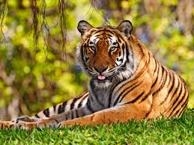
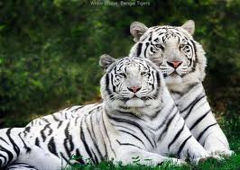
tiger
Tara is a tiger cub.

Slide 4
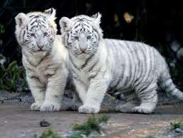
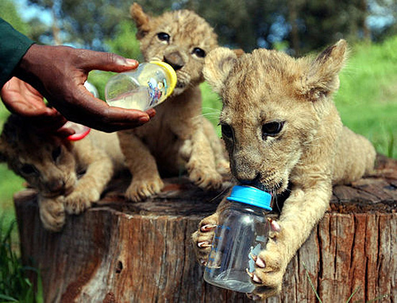
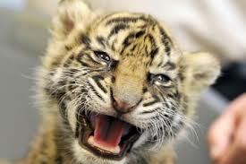
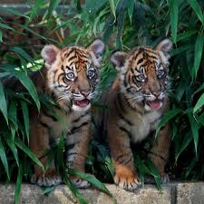
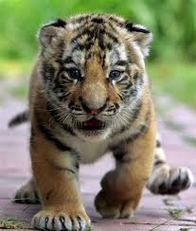
tiger cub

Slide 5
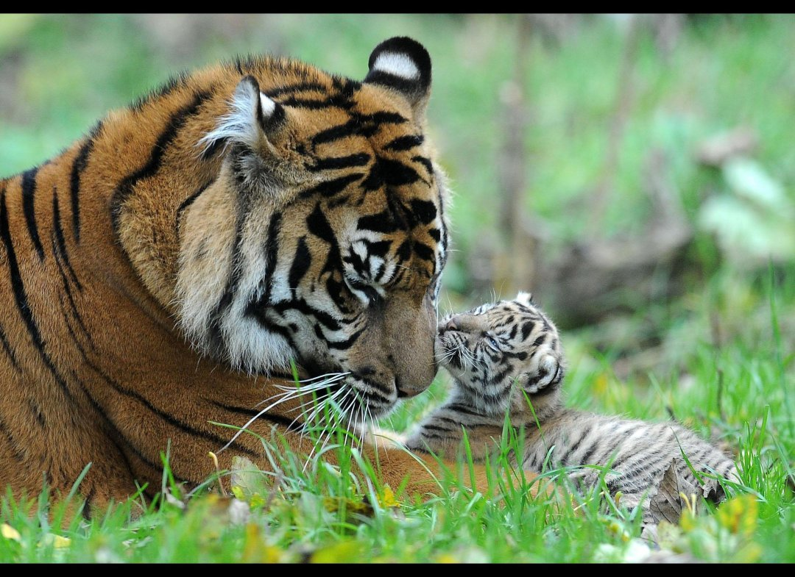

Slide 6
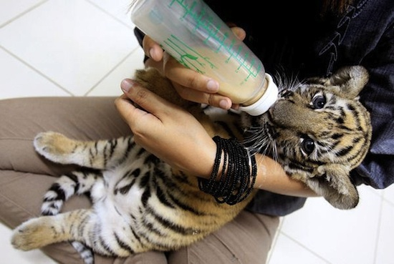

Slide 7
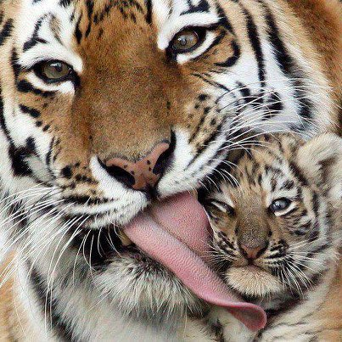

Slide 8
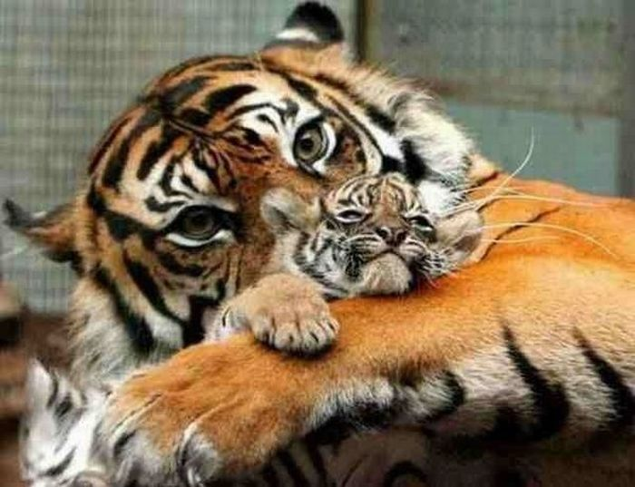

Slide 9
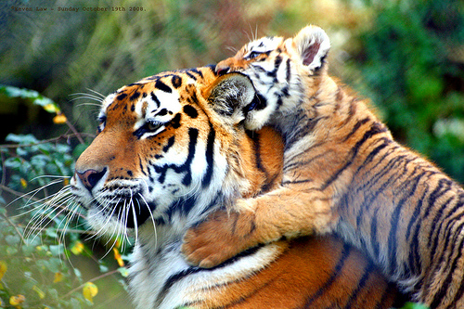

Slide 10
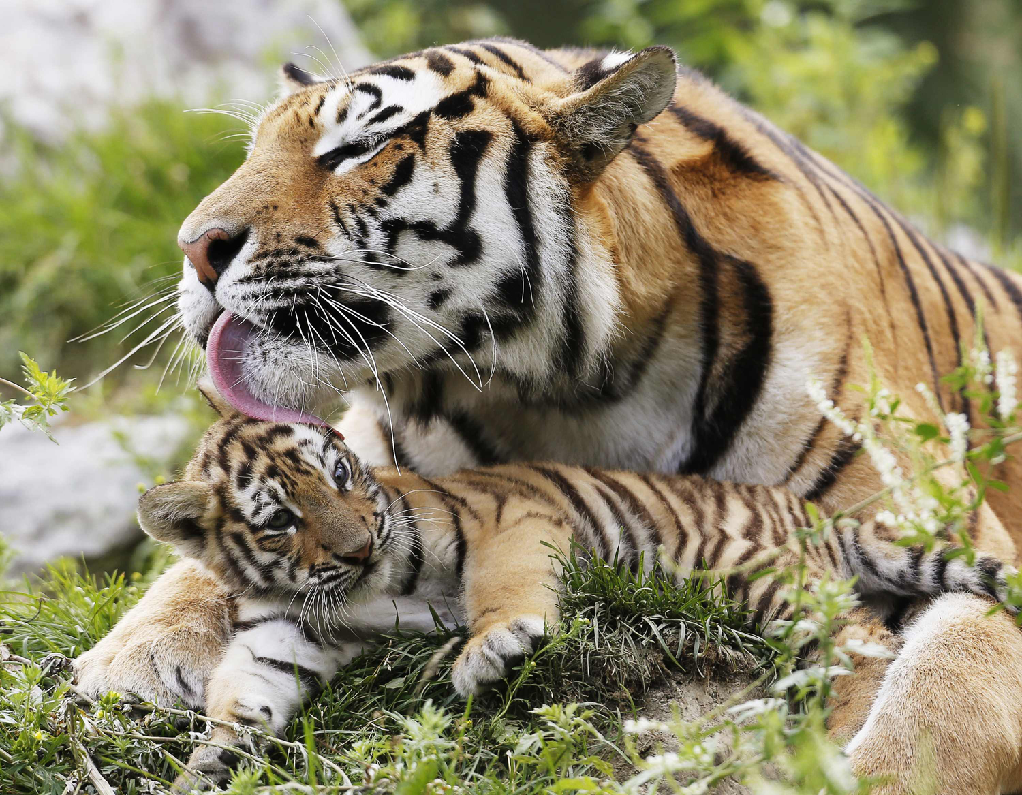

Slide 11
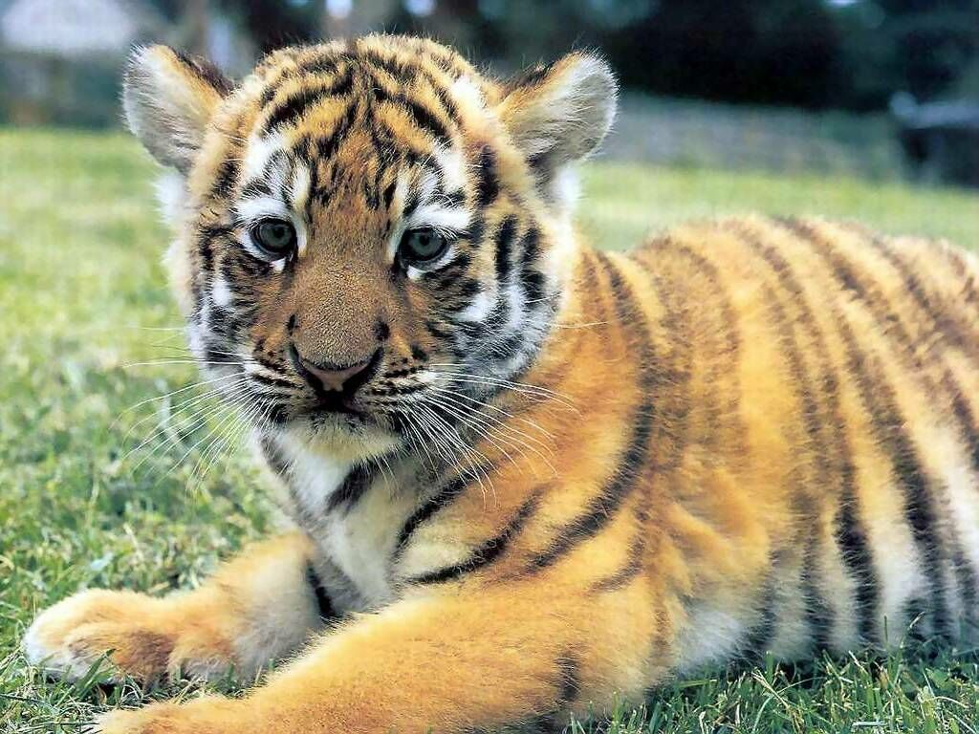

Slide 12
Tiger cub
Would you swim with a tiger cub? (1:03) http://www.youtube.com/watch?v=Hl2Wi31BR5c
A very sweet 3 week old tiger cub (1:01): http://www.youtube.com/watch?v=3aBJ-CJPnRQ

Slide 13
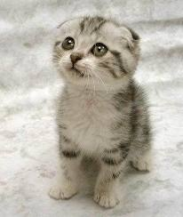
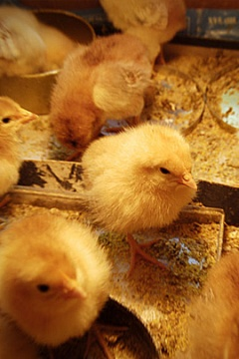
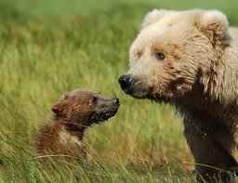
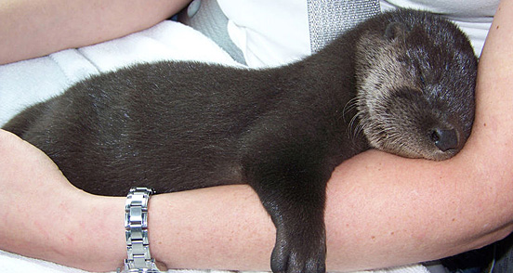
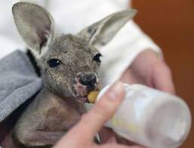
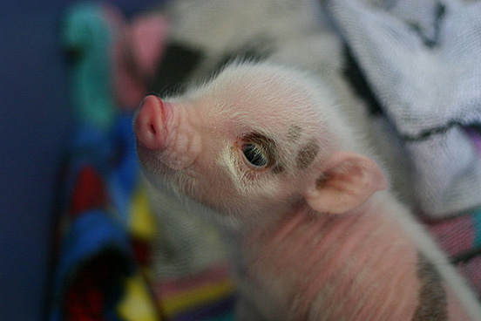
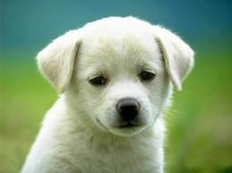
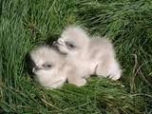
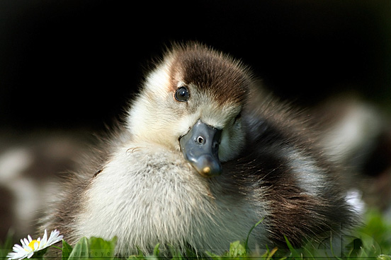
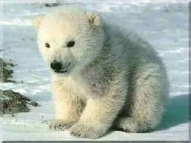
Other animal babies
bear—cub
dog—puppy
cat—kitten
kangaroo—joey
seal—pup
eagle—eaglet
duck—duckling
chicken—chick
seal—pup
pig—piglet

Slide 14
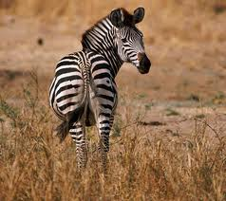
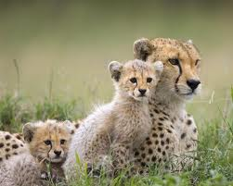
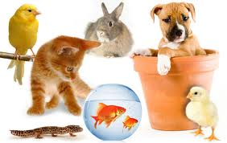
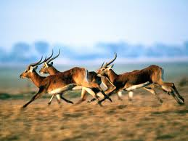
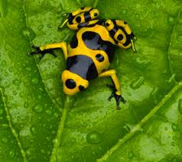
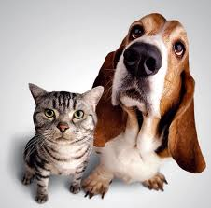
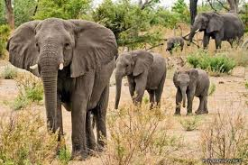
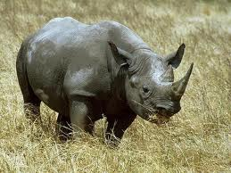
wild
Tara was born in a wild animal park.
wild tame

Slide 15
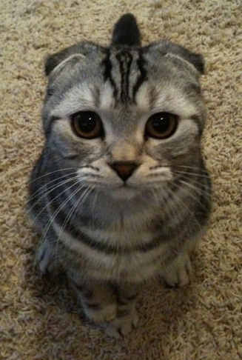
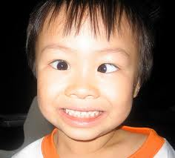
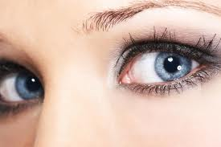
eyes
When Tara is 9 days old, her eyes opened.

Slide 16
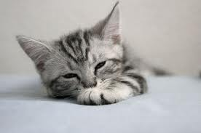
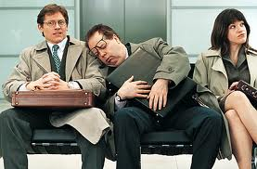
falls asleep
Tara falls asleep.

Slide 17
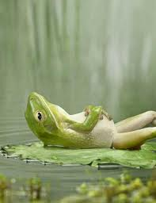
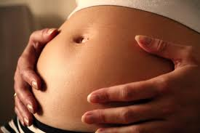
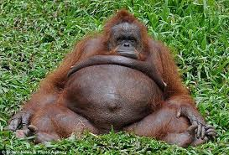
belly
Tara drinks until her belly is full.

Slide 18
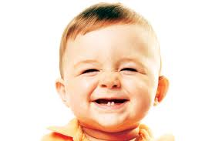
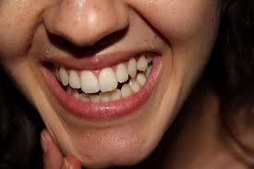
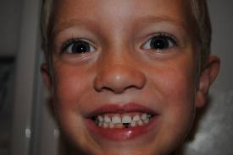
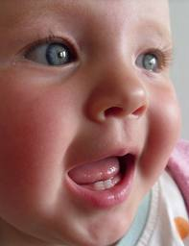
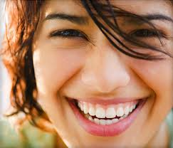
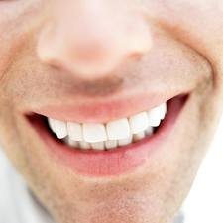
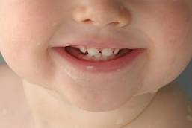
baby teeth
Tara’s baby teeth are coming in.
baby teeth adult teeth

Slide 19
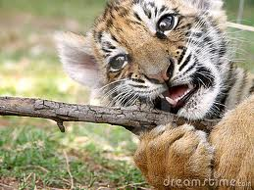
baby teeth- tigers
tiger cub baby teeth adult tiger teeth

Slide 20
pointed
Tara has pointed teeth for eating meat.

Slide 21
rounded
She also has rounded teeth for chewing.

Slide 22
meat
Every day Mary shows Tara a piece of meat. Tara does not want to try it yet.

Slide 23
learn
Playtime is a time to learn. Can Tara crawl over Mary’s legs?

Slide 24
scary
The bright lights are scary. The tiger cub roars.

Slide 25
roars
The bright lights are scary. The tiger cub roars.
This tiger’s roar might scare you! (0:25) http://www.youtube.com/watch?v=vXbzQun4AO0
Tigers don’t like to be in a cage! Listen to this tiger cub roar! http://www.youtube.com/watch?v=Ud17EbcBcQY

Slide 26
air
The air is filled with new smells.

Slide 27
climbing
Climbing over Lynn is fun.

Slide 28
Sight Words
enough
She is old enough to play outside.
across
She runs across the grass.

